Slide 1

Challenges for Billie Martian Office
Ahmed khalil

Slide 2
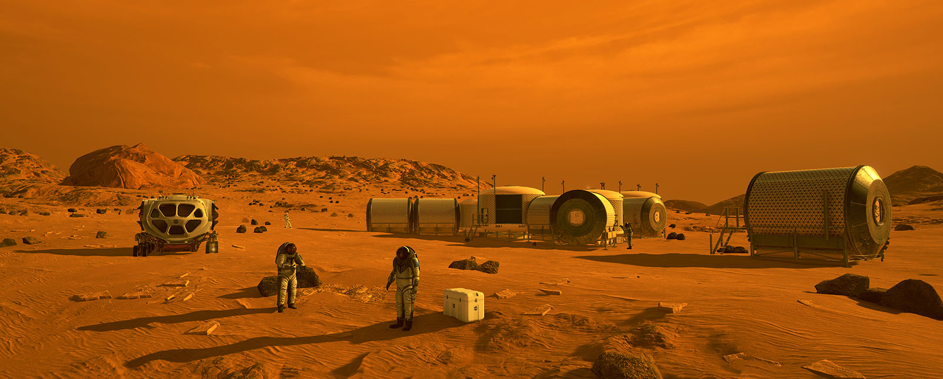
Current Mars Situation
MARS IS UNFORGIVING ENVIRONEMENT

Slide 3
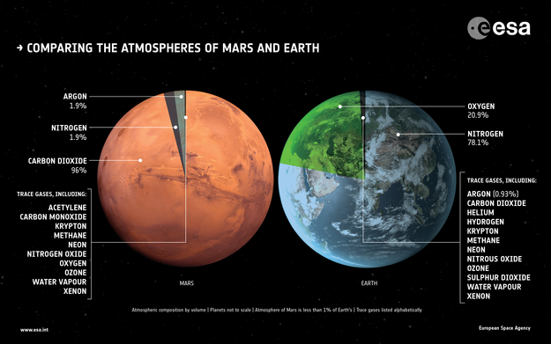
Mars Atmosphere
Mars is not a place for humans:
Earth has 78% nitrogen, 21% oxygen, 1% argon and other gases including CO2.
Mars has about 95% CO2(carbon dioxide), less than 3% nitrogen, less than 2% argon and only 0.2% oxygen. (And we need Oxygen to breath)
Mars average temperature is -60 °C.
Mars has a week gravity and a week magnetic field compared to Earth causing:
Failure on keeping gas including water vapor at the surface.
Major heath problem on human bones and muscles.
Alongside freezing temperature no liquid water is kept at Mars surface.
Mars surface exposition to space radiation making Mars soil a toxic environment for the planets which means No Food.

Slide 4
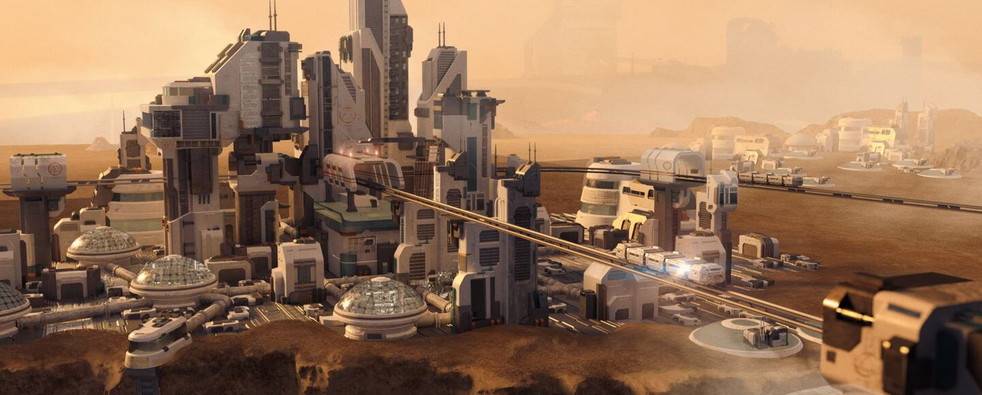
But…
By 2120 everything will be ok, how else Billie will be able to open an office on Mars.

Slide 5
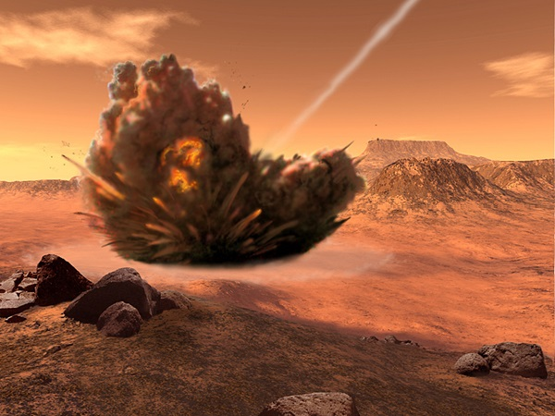
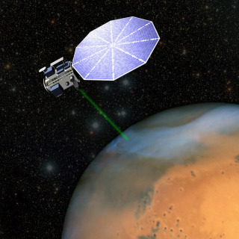
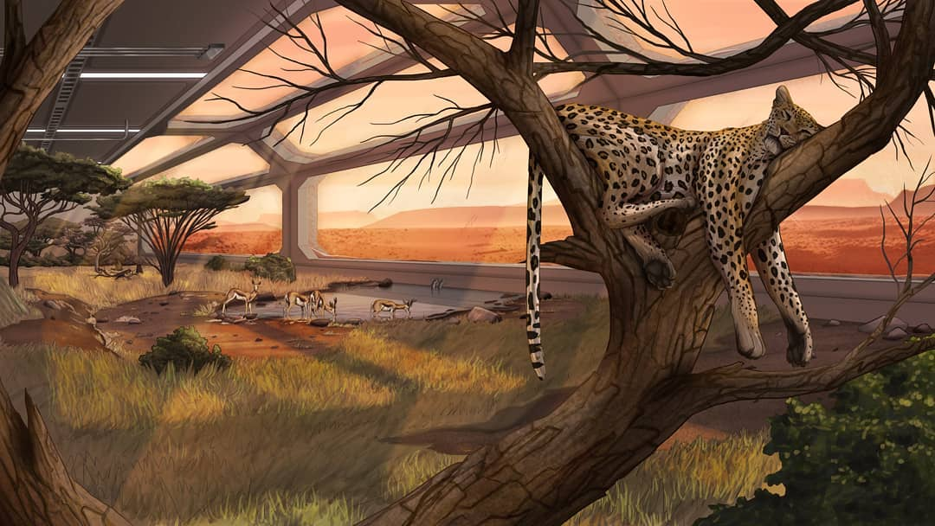
Mars is now ready
Mars can be ready for Billie’s office and employees:
By using giant mirrors orbit the plant reflecting sunlight back at Mars and heating it.
Building greenhouses providing food for the plant and working as gas factories on the surface of mars to heat it and make the Martian climate warmer similar to how fossil fuels warming Earth.
Flying nitrogen-rich asteroids attached with engines towards Mars making a collation with the surface. (It is estimated that four such impacts would be sufficient to create Earth-like conditions on Mars)

Slide 6
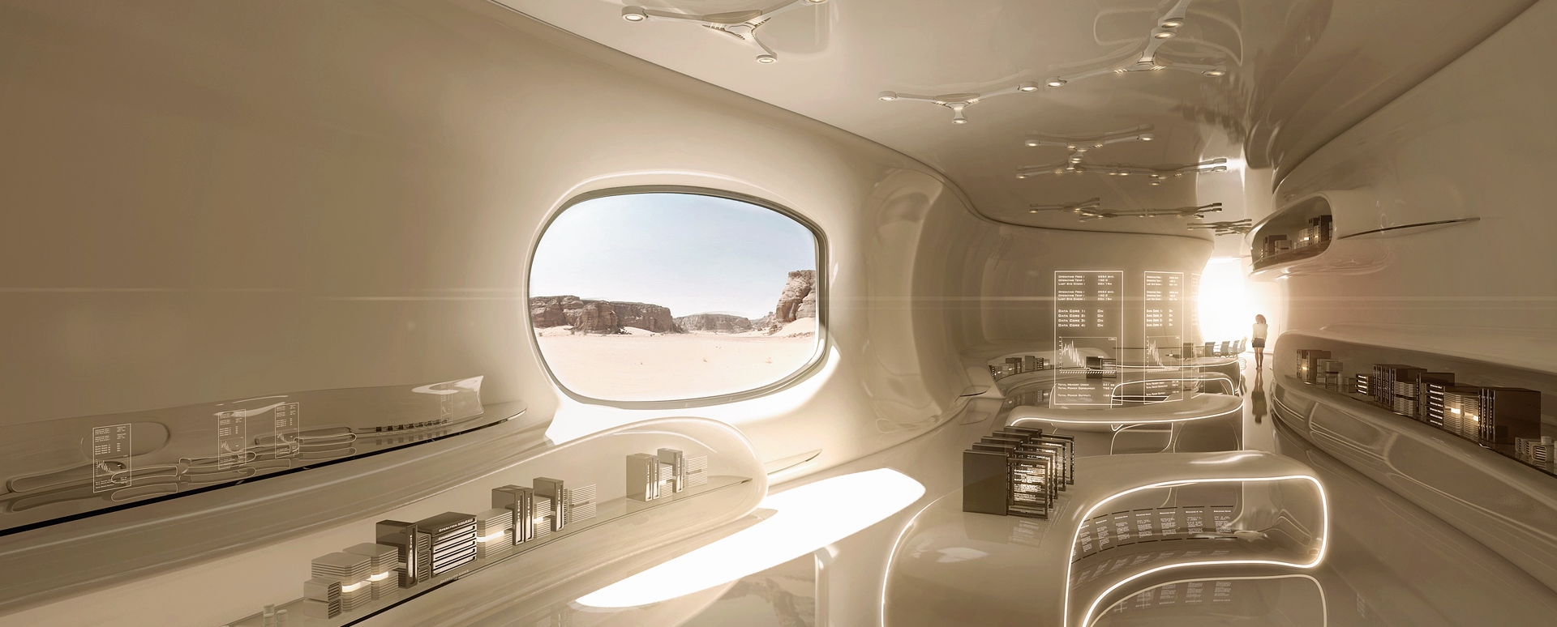


Billie office is ready
The past 100 years were extremely bright and successful. Billie conquered Europe, America, Africa and entire Earth. It turned out that the Martian B2B market looks pretty attractive. And it makes Mars a perfect destination for the next Billie’s office.

Slide 7
Billie is facing challenges on Mars
It doesn’t stop for Billie at making Mars habitable place for humans and making the essentials available:
Mars is now warmer so Billie’s employees can survive on a similar to Earth weather.
Water is now liquid forming lakes and oceans on Mars surface make it prettier and offering places for vacations for Billie’s employees.
Clean liquid water is now available so Billie’s employees aren’t thirsty anymore.
Mars cities provide oxygen and similar to Earth gravity so Billie’s employees can talk walks to Billie’s office and stay healthy.
Mars cities also provide the 22th century residential homes, entertaining facilities and outdoor parks so Billie’s employees can enjoy life.
Mars greenhouses provide vegetables, fruits and all types of food for Billie’s employees.
Mars cities are built with the fastest transportation channels.
But it doesn’t stop here…

Slide 8
After Essentials
With all the essentials covered, Billie’s Martian office is facing new challenges:
Communication with Earth offices is still a challenge, because the only way to send messages through space is using radio waves and by the time the radio waves reach Earth they often become week and need a huge radio receivers which will add enormous cost challenges.
Mars year is almost double the year length on Earth (687 days) which introduce new challenges:
When do the companies start, end and settle their financial year?
The number of yearly vacation days for Billie’s employees has to be adjusted.
Hiring new people from Earth and relocating them to Mars will be a challenge:
The estimation cost for the trip in 2020 is $6 billion, in 100 years the cost will be much less but it will still be very high for the employees to come to Mars and go to Earth to visit their families.
And with a single trip takes around 7 months it will be more harder to travel between Mars and Ears.
Maintaining and developing Mars cities will cost governments more money which will lead to higher tax rates on companies.

Slide 9
Solutions
Billie should invest and start working on developing smaller and cheaper radio waves receivers for easing the communication between Martian office and Earth offices.
Smart planning and planning for years in advance will cover Billie needs for new employees while growing in Mars.
Billie should start working on new financial rules and definitions for organizing the financial interaction between companies.
Billie Martian office needs to work on new financial plans to cover the costs of running an office on Mars.

Slide 10

See you soon!

